Slide 1
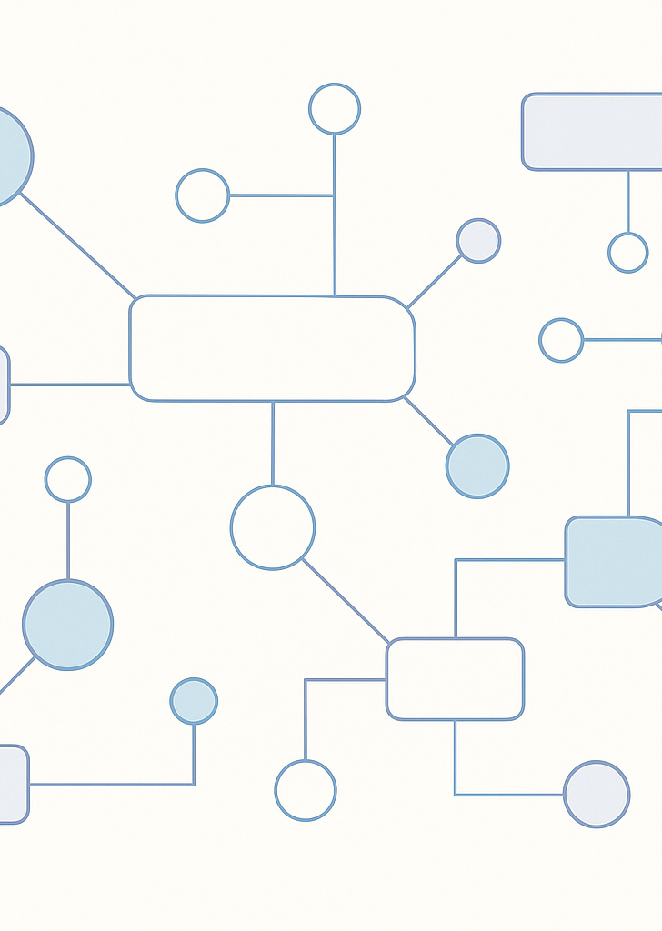
Lecture 10
UML Diagrams
Notations, Structures & Behaviour
October 12, 2025

Slide 2

Recap & Agenda
Last lecture, we explored the basics of UML:
• Class diagrams illustrate the static structure of a system
• Use case diagrams capture user interactions with the system
• Sequence diagrams show object interactions over time
Notations & UML building blocks
Relationships & multiplicity
Other structural diagrams
Behavioural diagrams overview
Examples & best practices

Slide 3
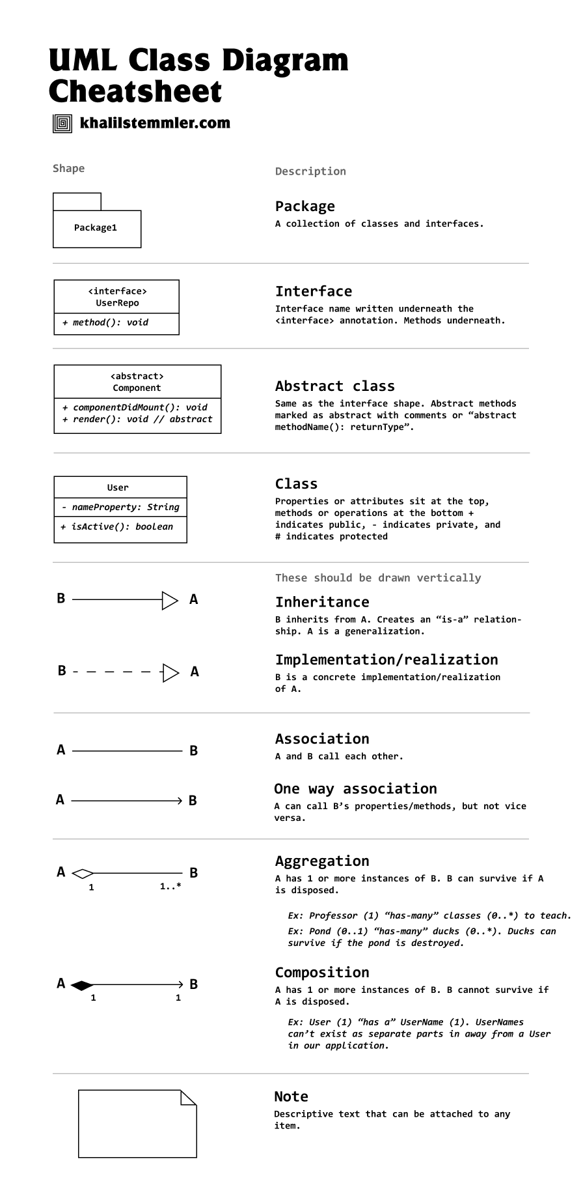
UML Notations
*Sometimes italics are used to represent abstract

Slide 4
Member access modifiers
All classes have different access levels depending on the access modifier (visibility). Here are the access levels with their corresponding symbols:
Public (+)
Private (-)
Protected (#)
Package (~)
Derived (/)
Static (underlined)
Underline in class name means it’s representing object,
Underline in attribute name means it’s a static variable/function

Slide 5





Relationships & Multiplicity
Dependency
Aggregation
A dashed arrow from one element to another indicates that a change in the supplier may require changes in the client.
Book
Chapter
Association
Solid line showing a structural connection between classes; multiplicity labels show how many instances participate.
Composition
Folder
File
Generalization
Hollow triangle arrow from child to parent represents inheritance – the child is a specialized form of the parent.
Aggregation
Hollow diamond indicates a whole–part relationship where parts can exist independently of the whole.
Composition
Filled diamond indicates a whole–part relationship where parts cannot exist outside the whole.

Slide 6
Relationship Examples
Dependency
Association
Client
Service
Person
1..*
1
Company
Generalization
Aggregation
Animal
Team
Player
Dog
Composition
Car
Engine

Slide 7
UML Notations
(Contd.)

Slide 8
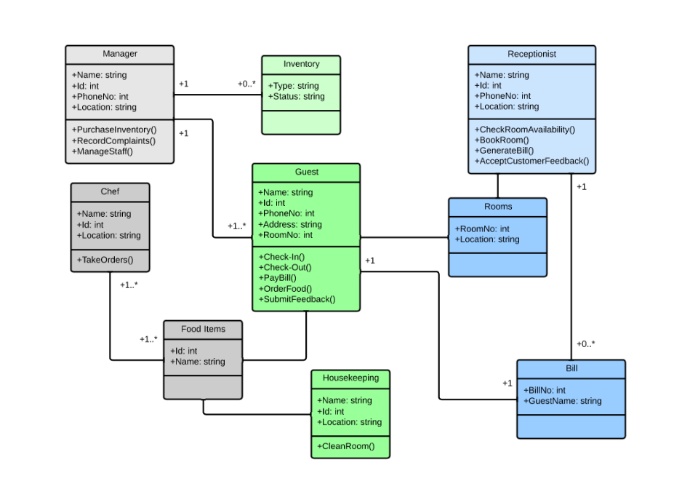
Class Diagram of Hotel Management System

Slide 9
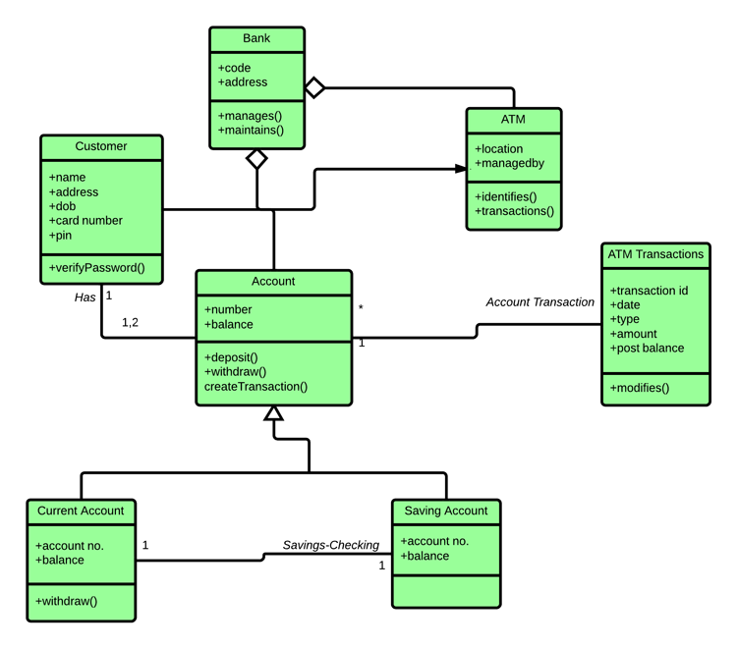
Class Diagram of ATM Machine

Slide 10
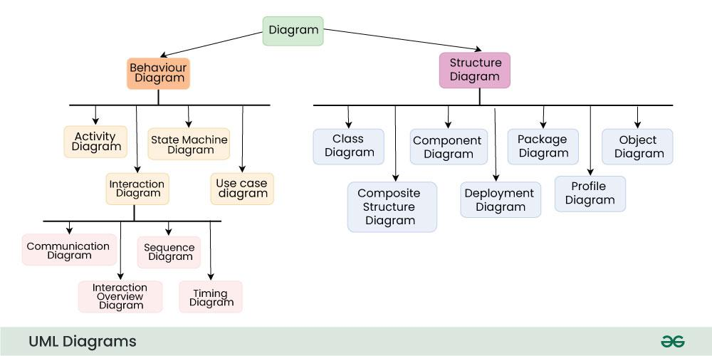

Slide 11
Object Diagram Example
Object diagrams capture a particular state of a system by illustrating the objects that exist and how they are linked.
They are especially helpful for validating class diagrams and exploring test scenarios.
Student
name = "Alice"
age = 20
Course
code = "CS101"
title = "Intro to CS"
enrolledIn

Slide 12
Deployment Diagram Example
Deployment diagrams map software components onto hardware nodes to describe the physical architecture.
Useful for illustrating distributed systems, cloud architectures and deployment strategies.
Web Server
DB Server
Web App
JDBC
MySQL

Slide 14






Behavioural Diagrams
Use Case
Sequence
Captures user goals and system interactions
Shows the chronological order of messages between objects
Activity
Communication
Models workflows and decision paths
Highlights object interactions and message routing
State Machine
Interaction Overview
Describes how an object transitions between states
Combines activity flow with references to other interaction diagrams
Timing
Focuses on state or value changes along a timeline

Slide 15
Choosing the Right Diagram
When to use…
• Use case diagrams: capture functional requirements and actors
• Class diagrams: model static structure of a system
• Sequence diagrams: describe the order of interactions
• Activity diagrams: model workflows and decisions
• State machines: illustrate life cycles of objects
• Component & deployment: show physical and logical modules
• Communication & interaction overview: emphasize object dialogue and big-picture flows

Slide 16
Best Practices
• Keep it simple: include only essential elements
• Consistent naming: use meaningful names for classes, methods and actors
• Logical layout: group related elements and align them clearly
• Use proper notation: leverage standard symbols for clarity
• Avoid overcrowding: split large models into multiple diagrams
• Keep diagrams updated: revise diagrams as the design evolves
• Validate with code & peers: cross‑check diagrams against implementation and review with colleagues

Slide 17
References
https://modeling-languages.com/best-uml-cheatsheets-and-reference-guides/
https://www.geeksforgeeks.org/system-design/unified-modeling-language-uml-introduction/
https://www.lucidchart.com/pages/uml-class-diagram
https://www.tutorialspoint.com/uml/uml_basic_notations.htm

